Slide 1
Leukemia Detection using Color Segmentation with OOMSD
Muhammad Afif Zafri Bin Khuzairi (2016734465)
Mohd Asyraf Bin Md Surani (2016728273)
Nor Kamaliah Binti Azhar (2016329539)
Nur Shahana binti Saat (2016351629)

Slide 2
Introduction
Leukemia is the one of the critical disease which known as cancer that in the modern era that widely infected among children and adults.
Leukemia disease can be prevented at an early stage before the cancer become more critical and high risk.
There have many technology can use in detection or recognize the leukemia cancer.
One is affected to leukemia if the percentage of WBC is higher than 20%.

Slide 3
Methodology
Image acquisition
OOM
Image segmentation
RGB
YcBcr
Image pre-processing
CMYK
Calculation and result
Cell counting
Feature extraction
Notes:
Summarize your research in three to five points.

Slide 4

Image Acquisition

Slide 5
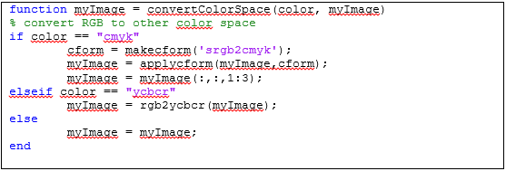
OOM
Convert RGB to CMYK and YcBcR

Slide 6
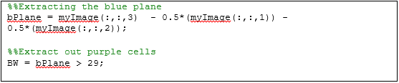
Image Segmentation
Segmentation of White Blood Cells

Slide 7
Image Preprocessing
Enhance image to remove noise

Slide 8

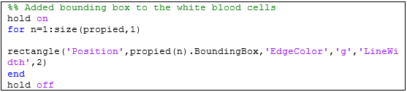
Feature Extraction
Add bounding box to the segmented white blood cells

Slide 9
Cell Counting
Count the total number of white blood cells

Slide 10
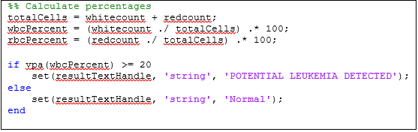
Calculation and Results
Calculate the percentage of WBCs and RBCs, determine if potential Leukemia detected

Slide 11

Result and Discussion
Name: Dr. Peter Maslak (MD)
Field: Hematologist
Position: Chief, Immunology Laboratory Service
Conditions Treated (Specialist):
Blood & Marrow Stem Cell Transplantation
Leukemia and Other Blood Cancers
Myelodysplastic Syndrome (MDS)
Locations: New York City
Phone: 212-639-5518
Dr Details Source:
https://www.mskcc.org/cancer-care/doctors/peter-maslak
https://imagebank.hematology.org/search-results?q=peter%20maslak%20leukemia

Slide 12
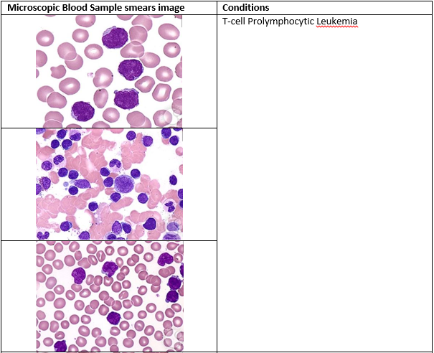
D
A
T
A
S
E
T
D
A
T
A
S
E
T

Slide 13
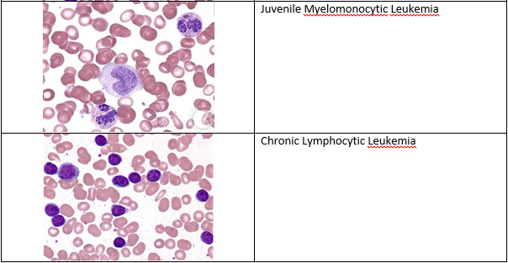
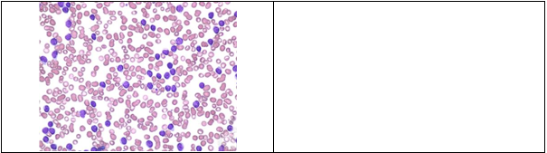
D
A
T
A
S
E
T
D
A
T
A
S
E
T

Slide 14
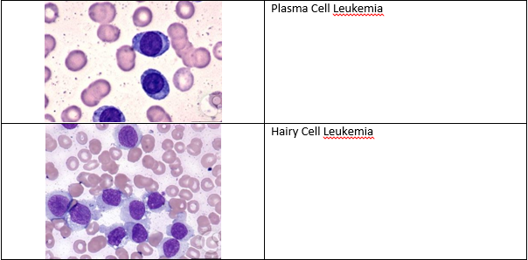
D
A
T
A
S
E
T
D
A
T
A
S
E
T

Slide 15
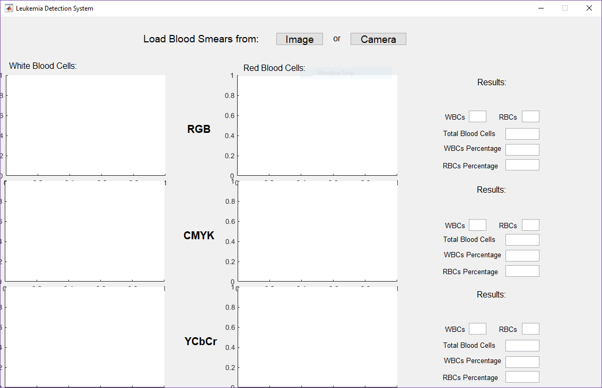
U
S
E
R
I
N
T
E
R
F
A
C
E
U
S
E
R
I
N
T
E
R
F
A
C
E

Slide 16
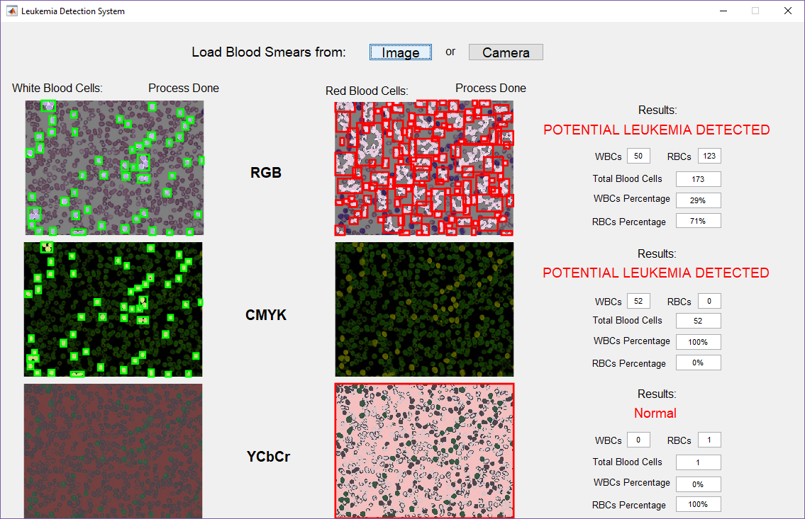
U
S
E
R
I
N
T
E
R
F
A
C
E
U
S
E
R
I
N
T
E
R
F
A
C
E

Slide 17
Main aim is to calculate the percentage of WBCs in blood cell in order to detect leukemia by using OOM. This project shows the comparison of detection by using RGB, CMYK, and YcBcr color detection.
Different Color spaces may offers different result in the cells segmentation. As example, CMYK may offers more accurate segmentation compared to RGB.
Conclusion

Slide 18
THANK YOU

